Slide 1
Luck Sampling for STM measurements
By Patrick Van Workum

Slide 2
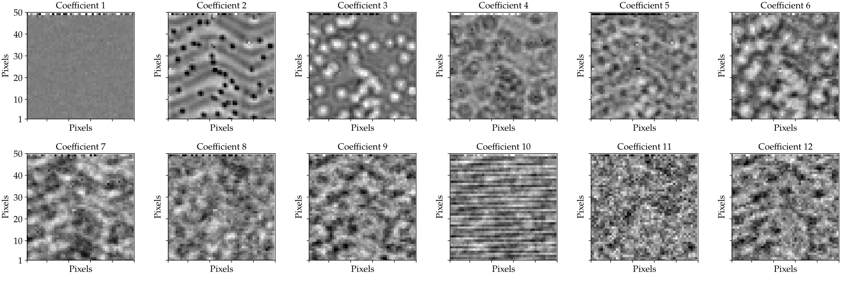
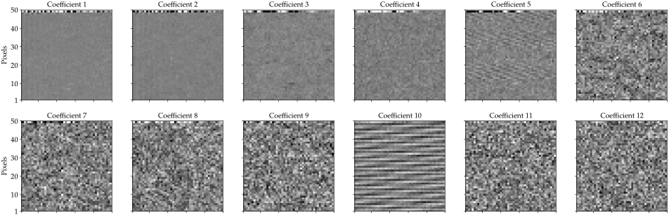
Understanding the data
Real
Displayed are the first 12 real and complex harmonic components from the STM experiment on 18/06/2021.
Plots represent the mean value of pixel for each coefficient, with color mapping bound by ±3 standard deviations.
Complex
Notes:
More information?

Slide 3
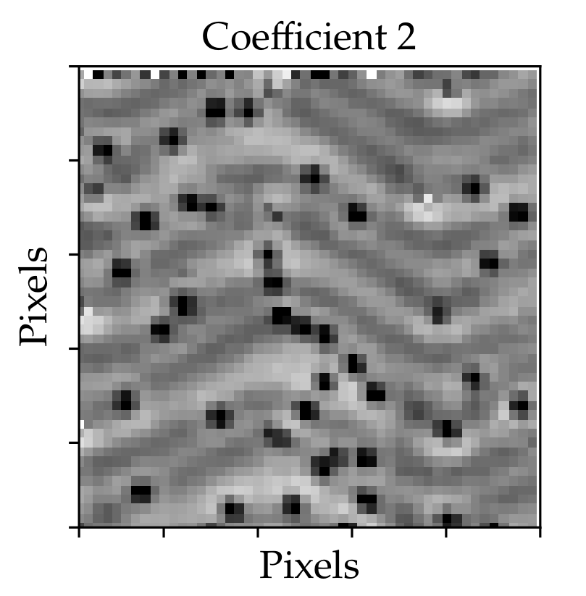
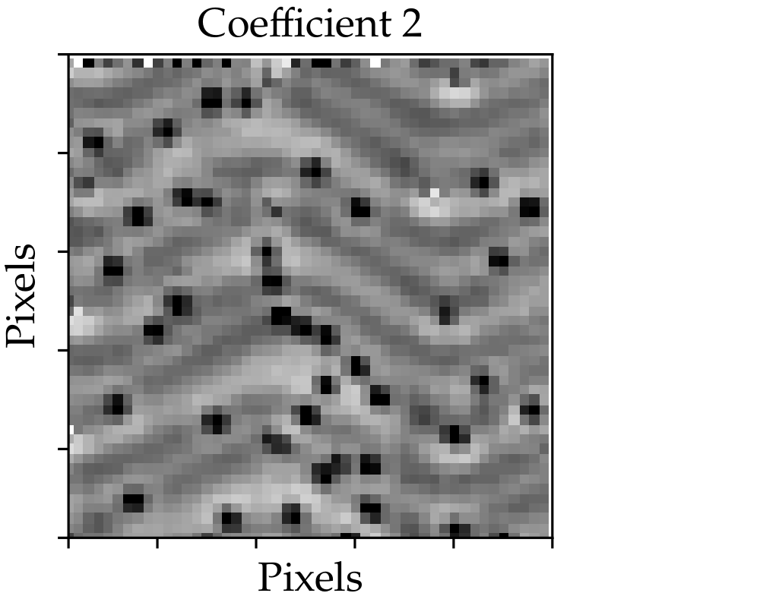
Other statistic measurements
Figure 1) Mean of each pixel’s values, colour mapping; mean ± 3 standard deviation.
Figure 2) Median of pixel’s values, colour mapping; median ± 3 standard deviation.
Notes:
All images are taken from the real component

Slide 4
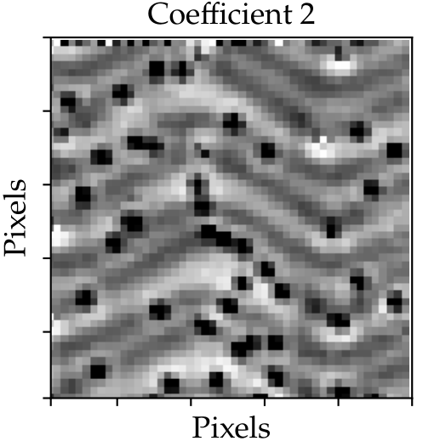
Other statistic measurements
Figure 1) Mean of each pixel’s values, colour mapping; mean ± 3 standard deviation.
Figure 2) Median of pixel’s values, colour mapping; median ± 3 standard deviation.
Figure 3) Mean of each pixel’s values, colour mapping; mean ± 2 standard deviation.
Notes:
All images are taken from the real component

Slide 5
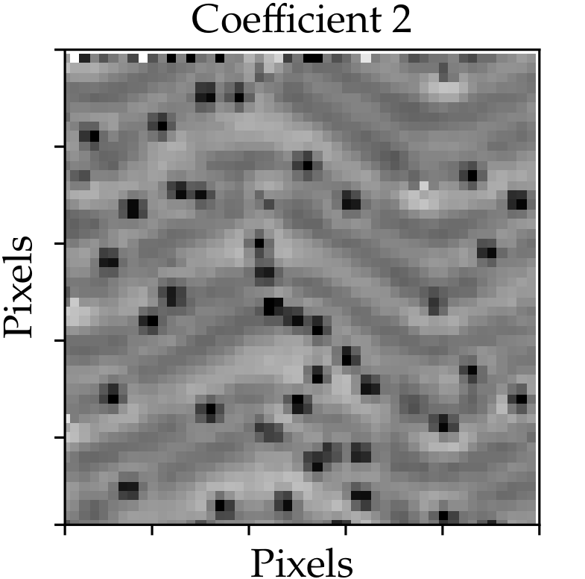
Other statistic measurements
Figure 1) Mean of each pixel’s values, colour mapping; mean ± 3 standard deviation.
Figure 2) Median of pixel’s values, colour mapping; median ± 3 standard deviation.
Figure 3) Mean of each pixel’s values, colour mapping; mean ± 2 standard deviation.
Figure 4) Mean of each pixel’s values, colour mapping; mean ± 4 standard deviation.
Notes:
All images are taken from the real component

Slide 6
Other statistic measurements
Figure 1) Mean of each pixel’s values, colour mapping; mean ± 3 standard deviation.
Figure 2) Median of pixel’s values, colour mapping; median ± 3 standard deviation.
Figure 3) Mean of each pixel’s values, colour mapping; mean ± 2 standard deviation.
Figure 4) Mean of each pixel’s values, colour mapping; mean ± 4 standard deviation.
Notes:
All images are taken from the real component

Slide 7
Other statistic measurements
Figure 1) Mean of each pixel’s values, colour mapping; mean ± 3 standard deviation.
Figure 2) Median of pixel’s values, colour mapping; median ± 3 standard deviation.
Figure 3) Mean of each pixel’s values, colour mapping; mean ± 2 standard deviation.
Figure 4) Mean of each pixel’s values, colour mapping; mean ± 4 standard deviation.
Notes:
All images are taken from the real component

Slide 8
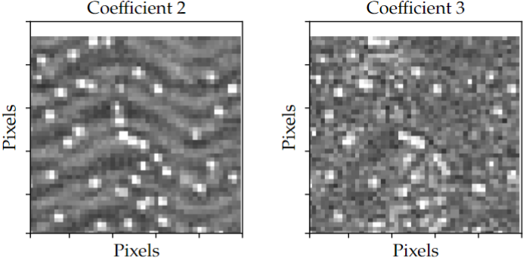
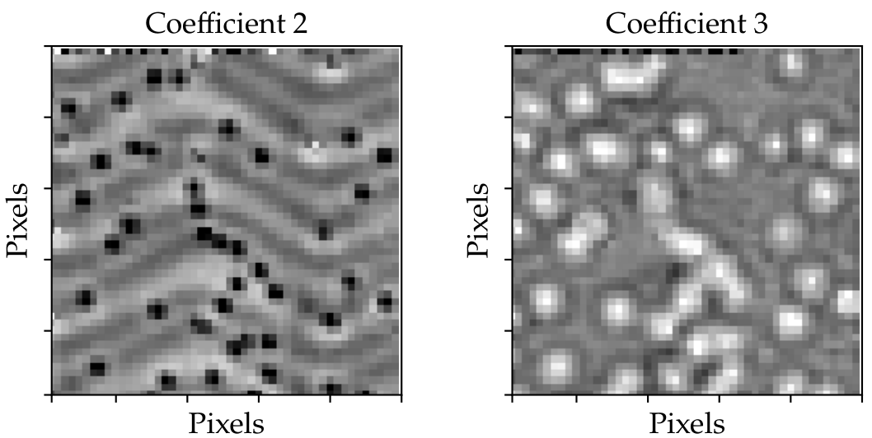
Root Mean Square
Figure 5) RMS of each pixel’s values, colour mapping; RMS ± 3 standard deviation.
Figure 1) Mean of each pixel’s values, colour mapping; Mean ± 2 standard deviation.
Notes:
Is this interesting results

Slide 9
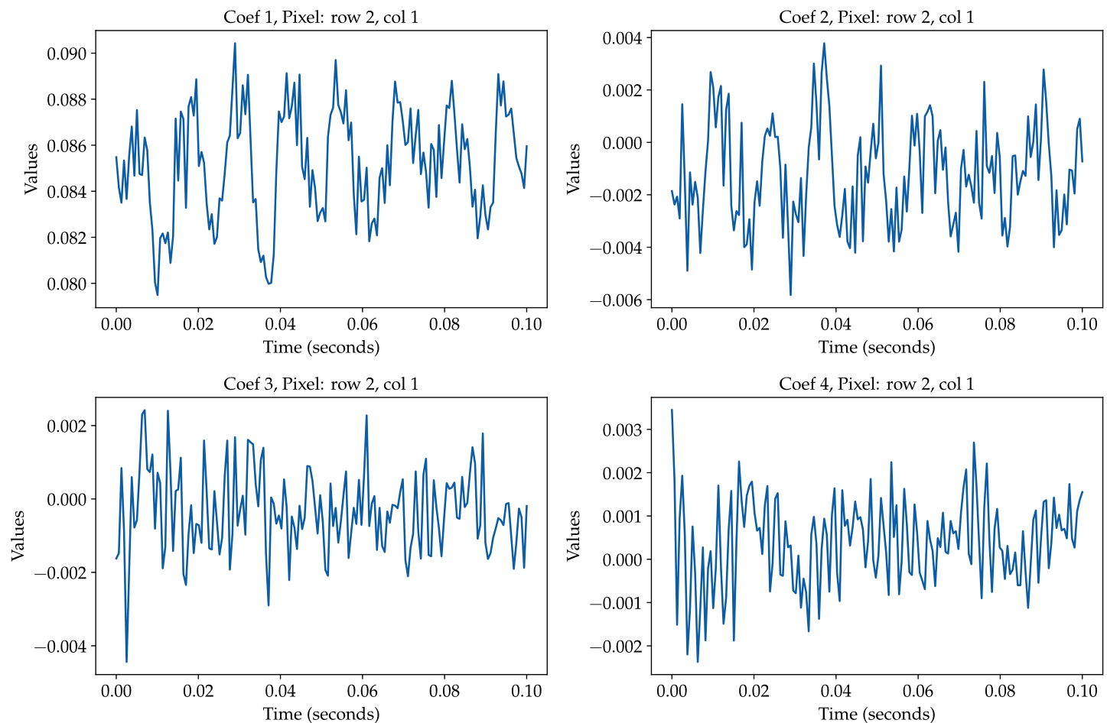
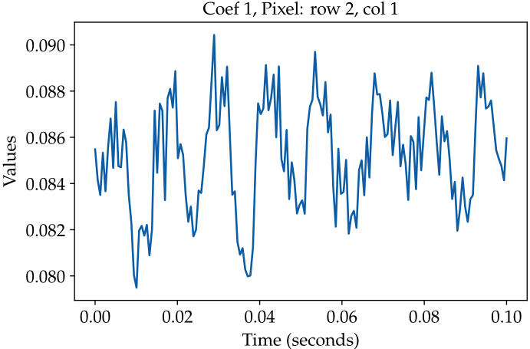
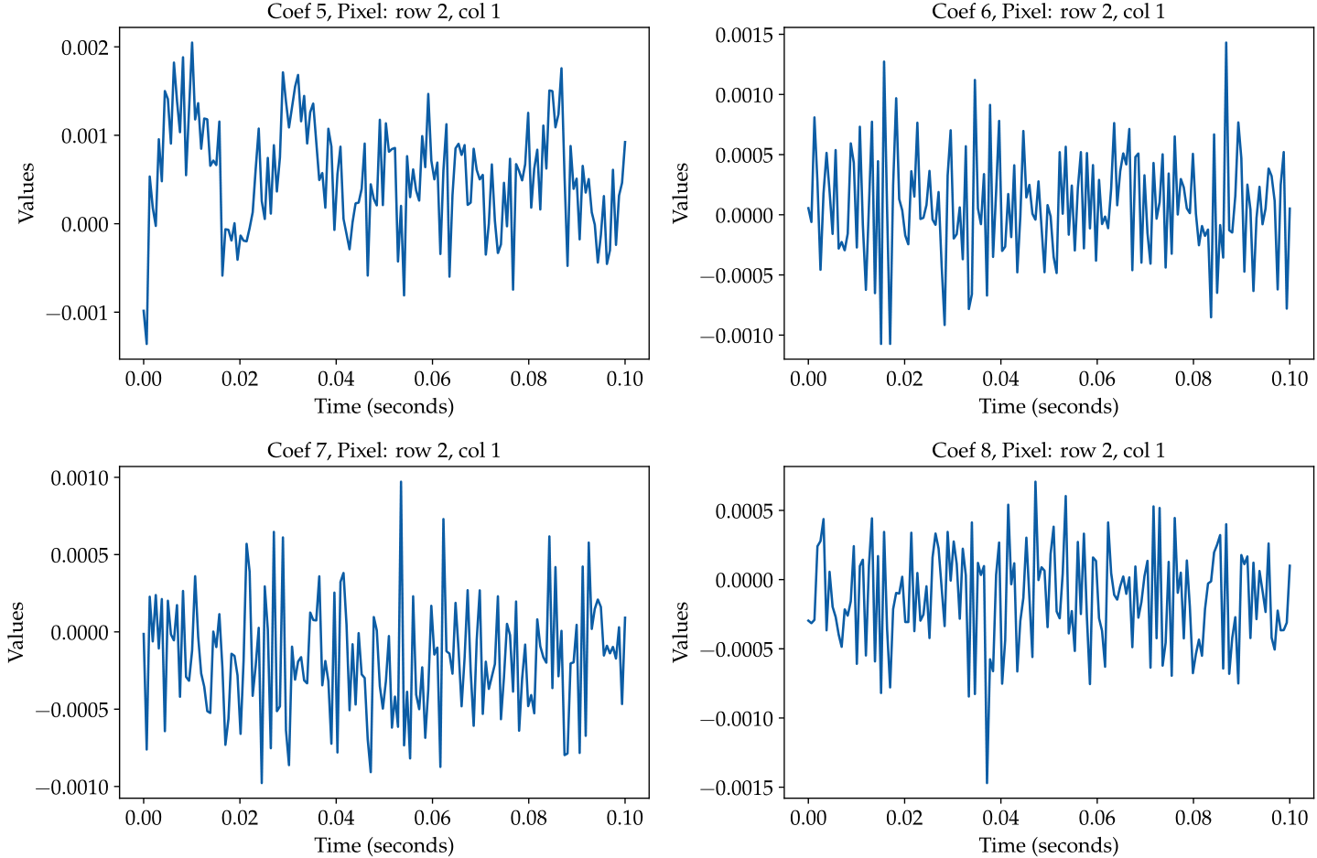
Looking at a single Pixel
A single pixel has 160 datapoints captured over 0.1 seconds.
The image is 50x50 pixels, with 31 real and complex coefficients
The dataset contains 24.8 million points, or 155,000 after averaging.
Significant variation exists within each coefficient's values for any pixel.
Sharp resolution
Remove noise
Notes:
A single pixel consists of 160 data points collected over a 0.1-second interval. The full image is 50x50 pixels, with 31 coefficients for both real and complex components, resulting in a dataset of 24,800,000 points, or 155,000 when averaged. Analyzing the coefficients for any pixel reveals significant variation within the values. Is there a more effective analytical approach to improve the results beyond simply averaging? Can we achieve sharper resolution and reduce noise?

Slide 10
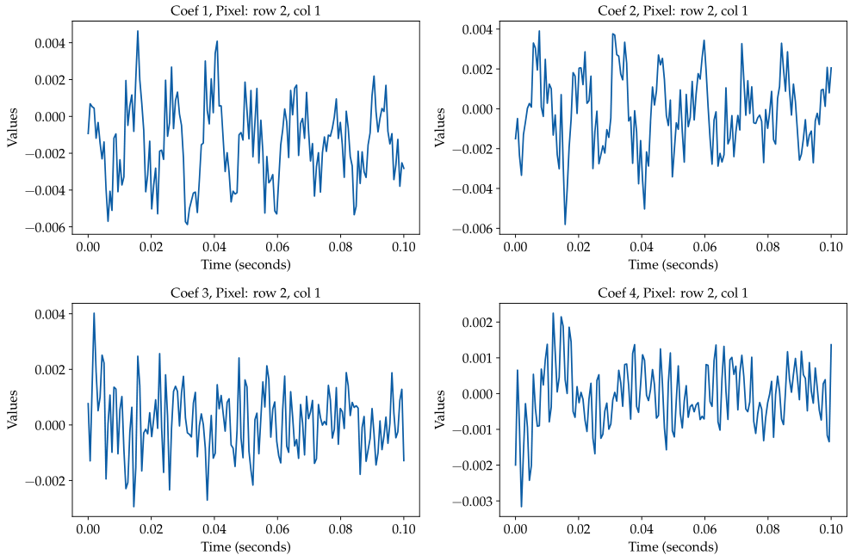
Complex coefficient
Notes:
Shows complex component time series of the coefficient 1 – 4 for pixel (2,1)

Slide 11
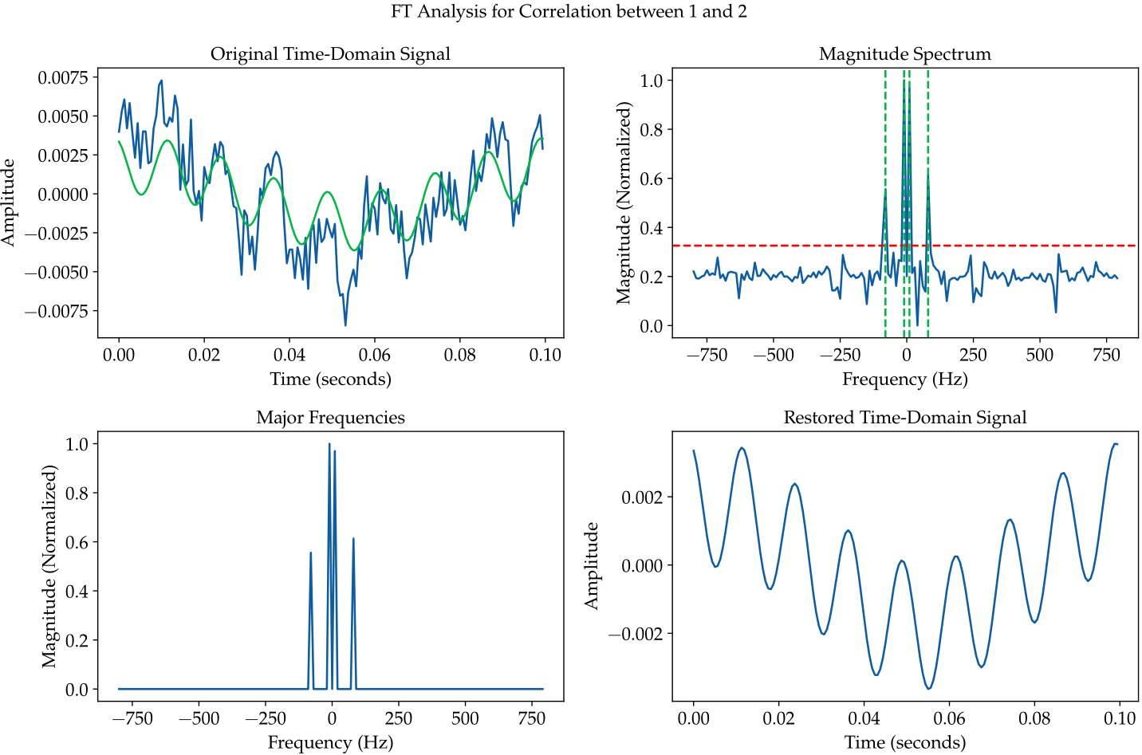
Fourier Transform Slicing
Notes:
Correlate coefficient 1 to other coefficients and subtracting off the Coefficient 1
Apply a FT on the data. Extract out the Major frequencies.
Create a new signal using only these frequencies
Slice the original coefficient data based on the peaks on the Signal

Slide 12
Fourier Transform Slicing
Notes:
Correlate coefficient 1 to other coefficients and subtracting off the coefficient 1

Slide 13
Fourier Transform Slicing
Notes:
Apply a FT on the data. Extract out the Major frequencies.

Slide 14
Fourier Transform Slicing
Notes:
Create a new signal in the frequency domain

Slide 15
Fourier Transform Slicing
Notes:
Reverse the new created signal back into the time domain

Slide 16
Fourier Transform Slicing
Notes:
Correlate coefficient 1 to other coefficients and subtracting off the Coefficient 1
Apply a FT on the data. Extract out the Major frequencies.
Create a new signal in the frequency domain
Reverse the new created signal back into the time domain

Slide 17
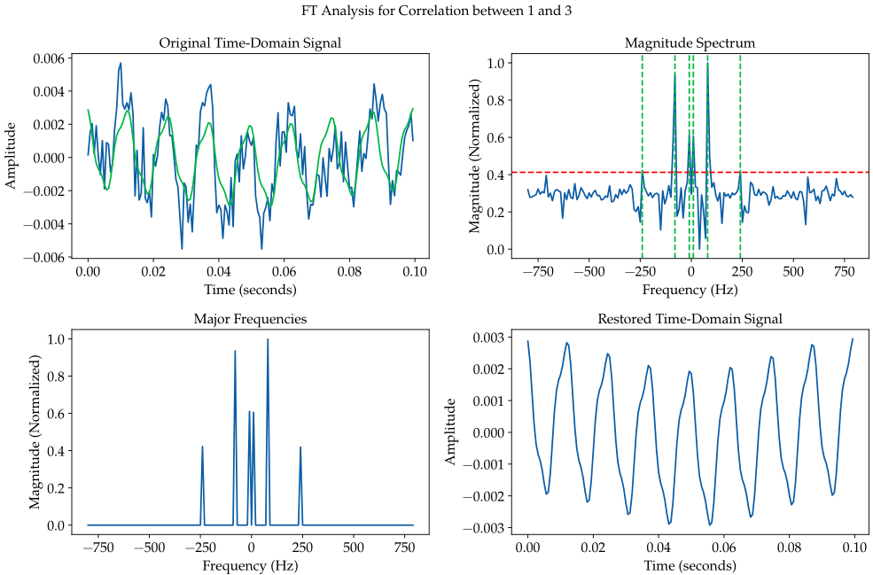
Real Coefficient Pixel (2,1)
Notes:
FT analysis applied to real component of coefficient 3 on pixel (2,1)

Slide 18
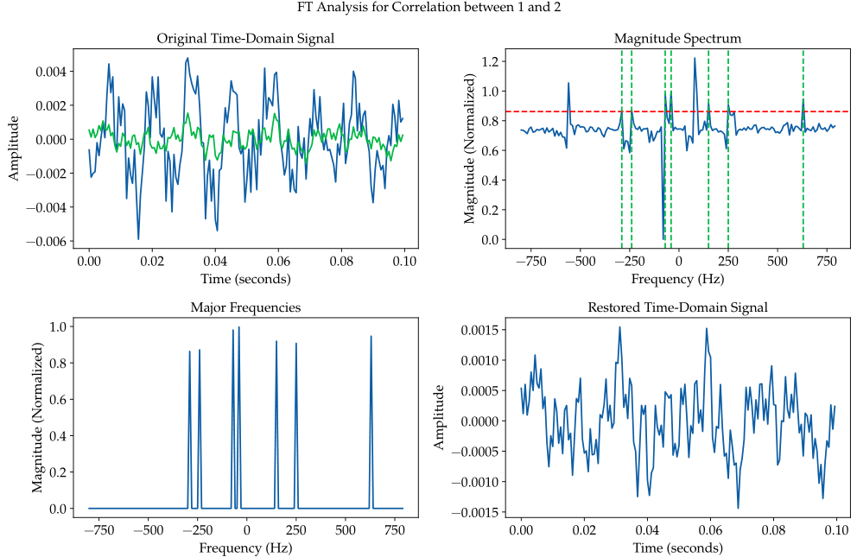
Complex Coefficient Pixel (2,1)
Notes:
FT analysis applied to complex component of coefficient 2 on pixel (2,1)

Slide 19
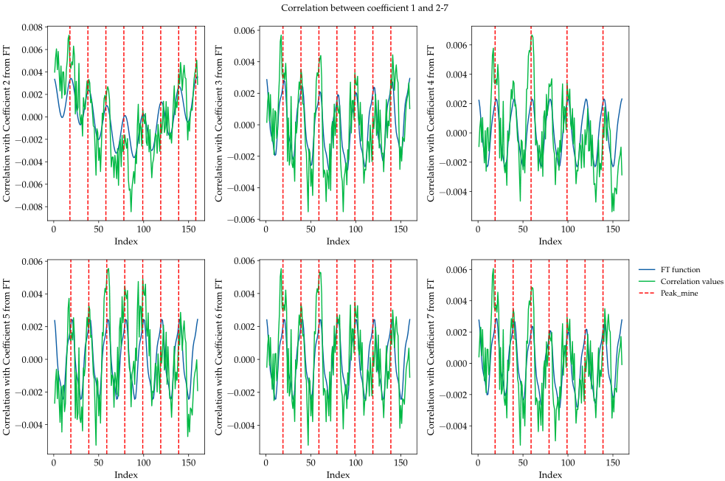
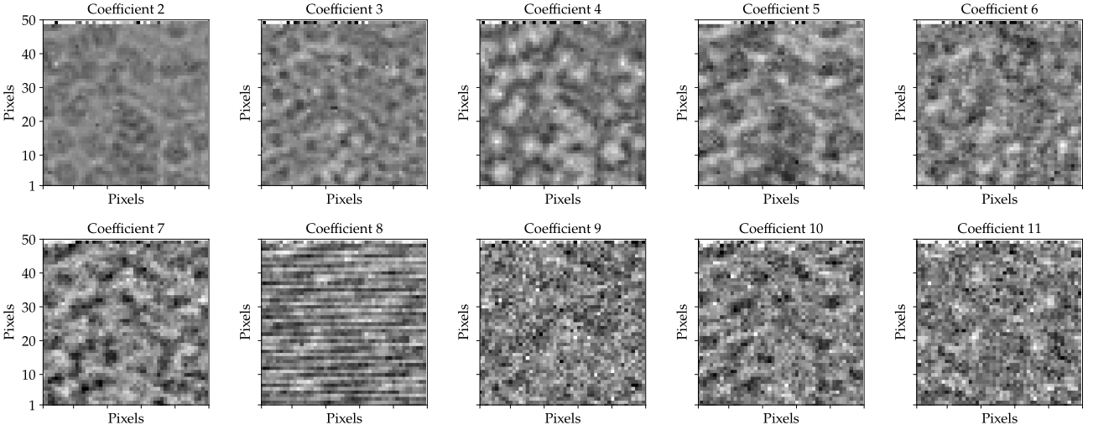
Fourier Transform Slicing
Notes:
Slice the original coefficient data based on the peaks on this new created Fourier signal

Slide 20
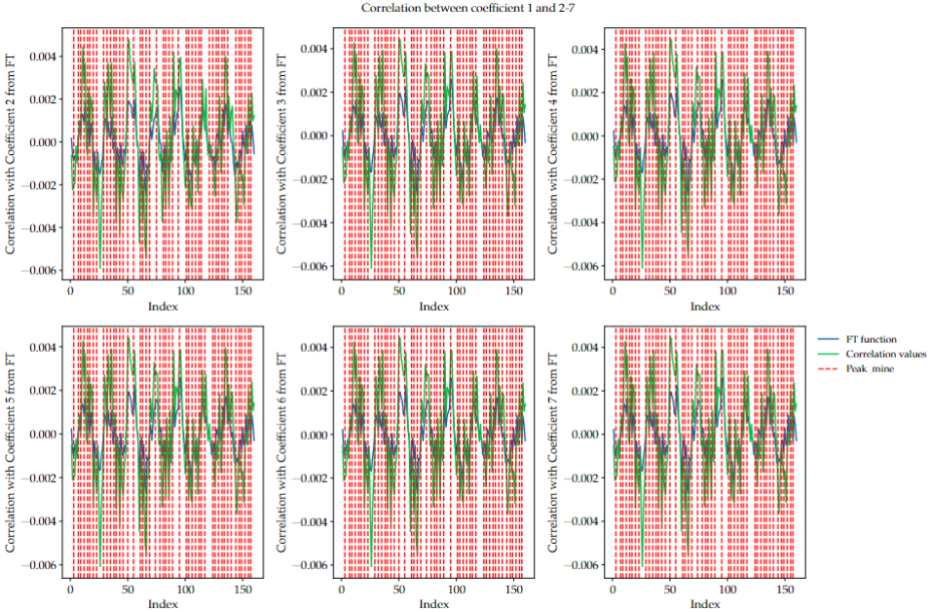
Fourier Transform Slicing
Notes:
Slice the original coefficient data based on the peaks on this new created Fourier signal

Slide 21
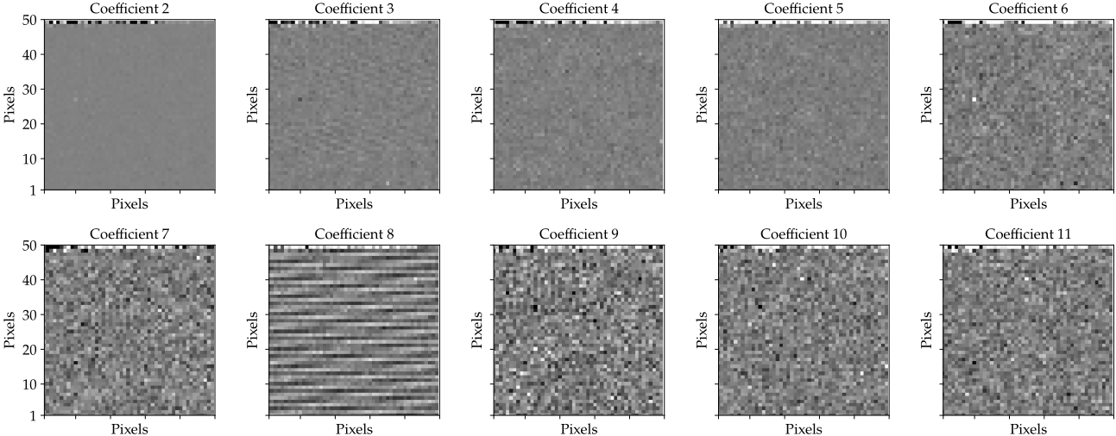
Fourier Transform Slicing
Real
Real
Complex
Notes:
Taking the slice data, take the mean and same starred colour mapping as shown on slide 3. Plot the result.

Slide 22
Fourier Transform Slicing
Real
Real
Complex
Notes:
Taking the slice data, take the mean and same starred colour mapping as shown on slide 3. Plot the result.

Slide 23
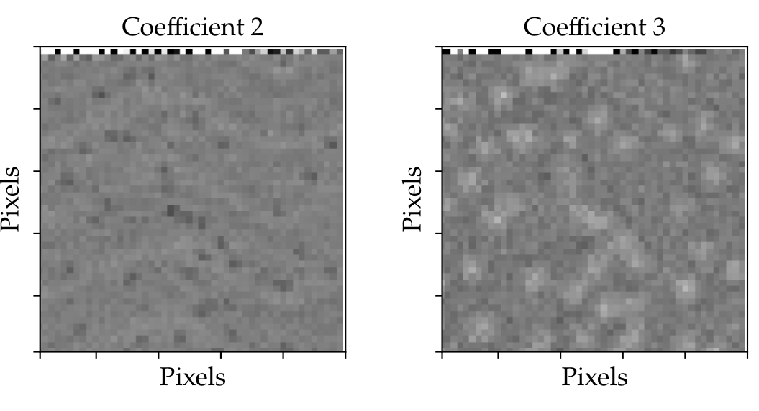
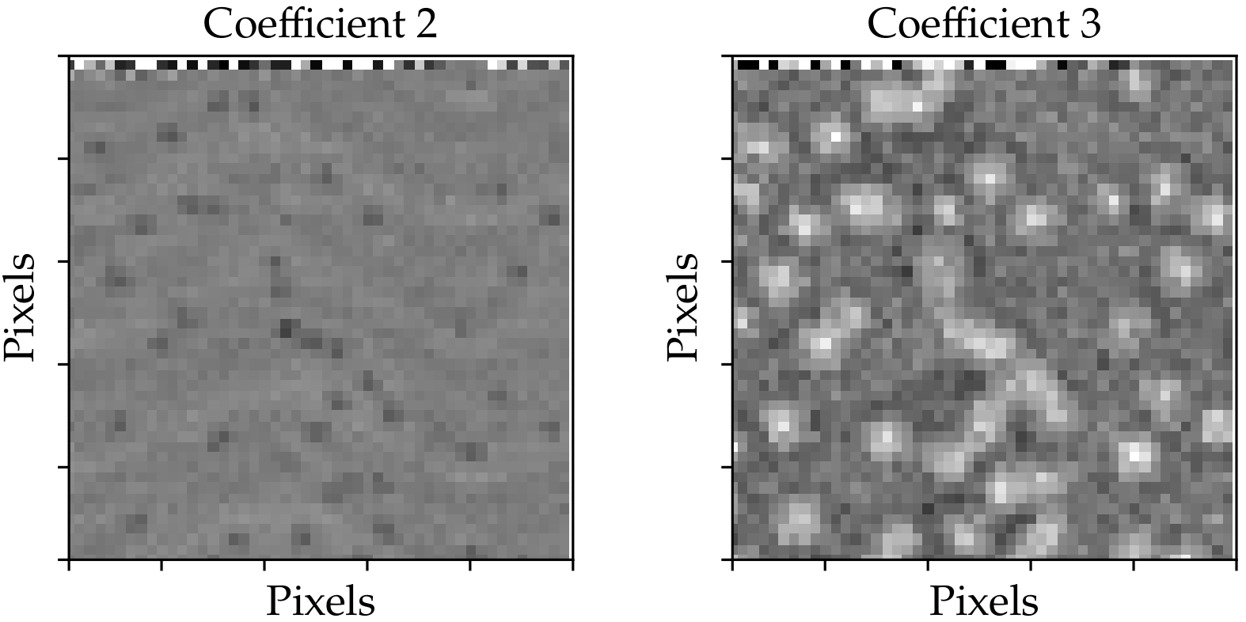
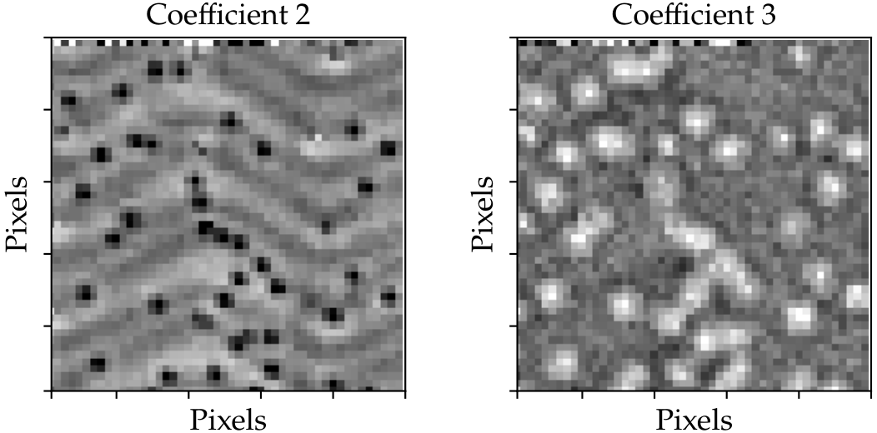
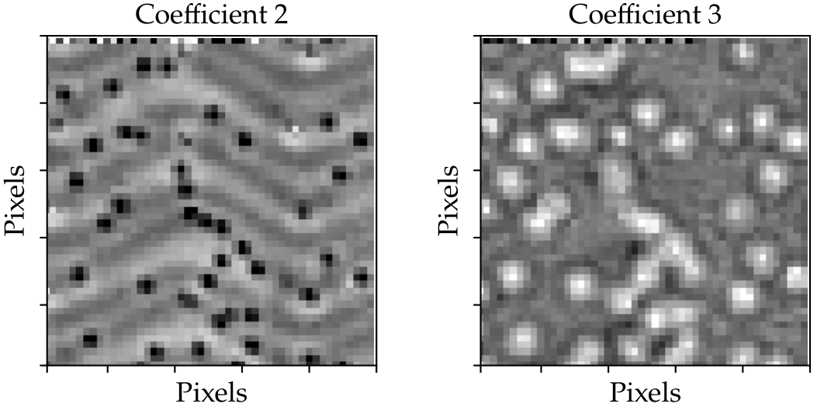
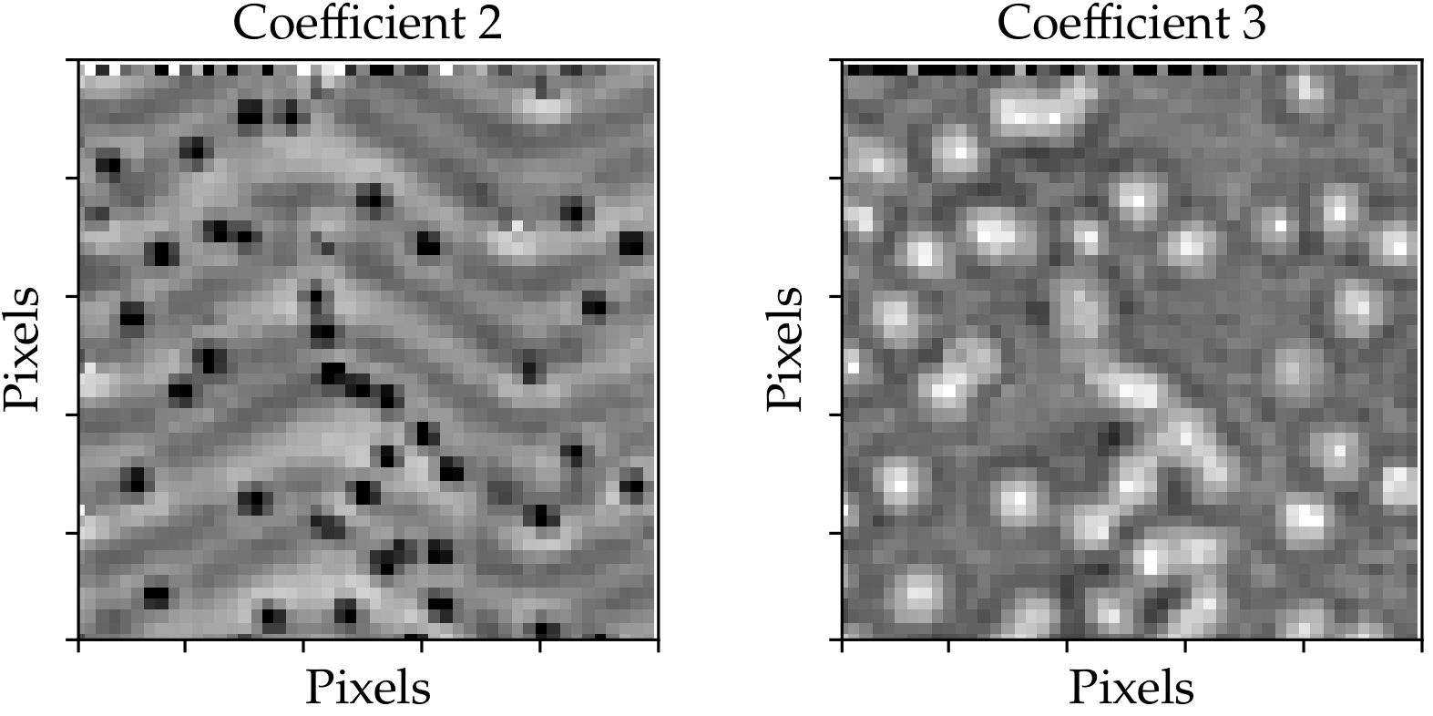
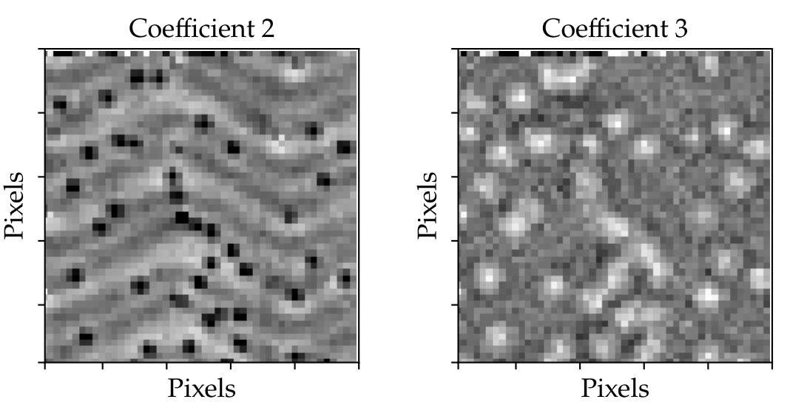

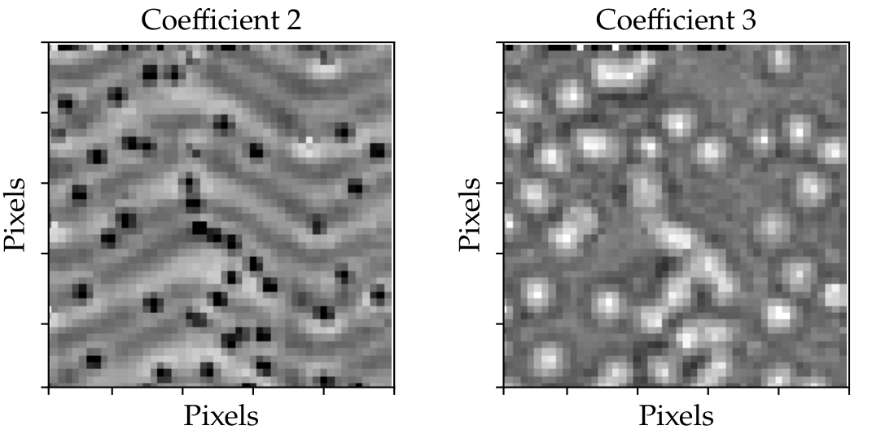
Slicing time periods
Last 5 values
Last 10 values
Last 20 values
Last 40 values
Last 80 values
All values
Last 20 values
Last 40 values
Last 80 values
First 20 values
First 40 values
First 80 values

Slide 24
Slicing time periods
Last 5 values
Last 10 values
Last 20 values
Last 40 values
Last 80 values
Last 20 values
Last 40 values
Last 80 values
First 20 values
First 40 values
First 80 values

Slide 25
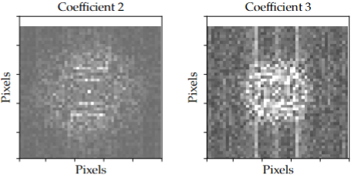
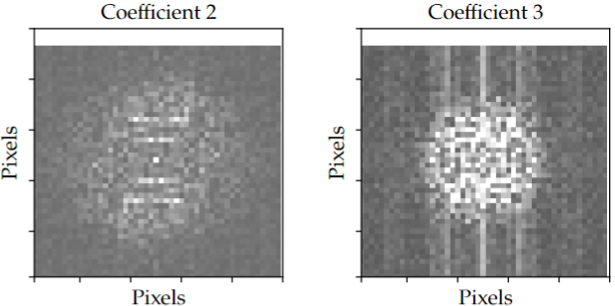
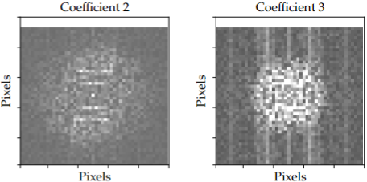
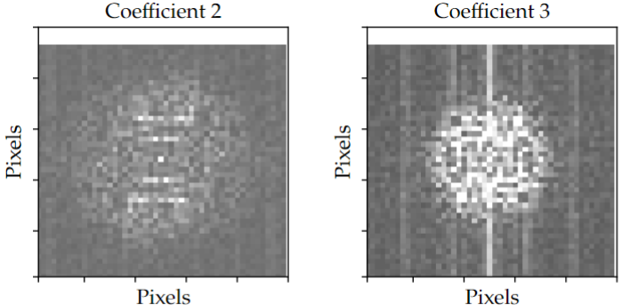
2D FT sliced time periods
20 values
80 values
40 values
DICE Value;
All values

Slide 26
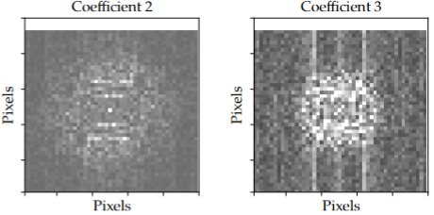
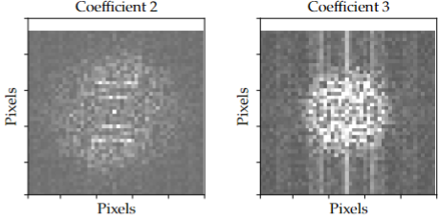
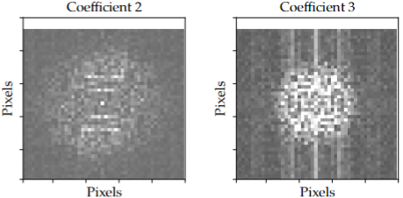
2D FT reversed sliced time periods
20 values
80 values
40 values
All values

Slide 27
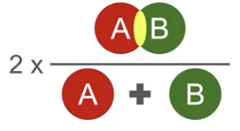
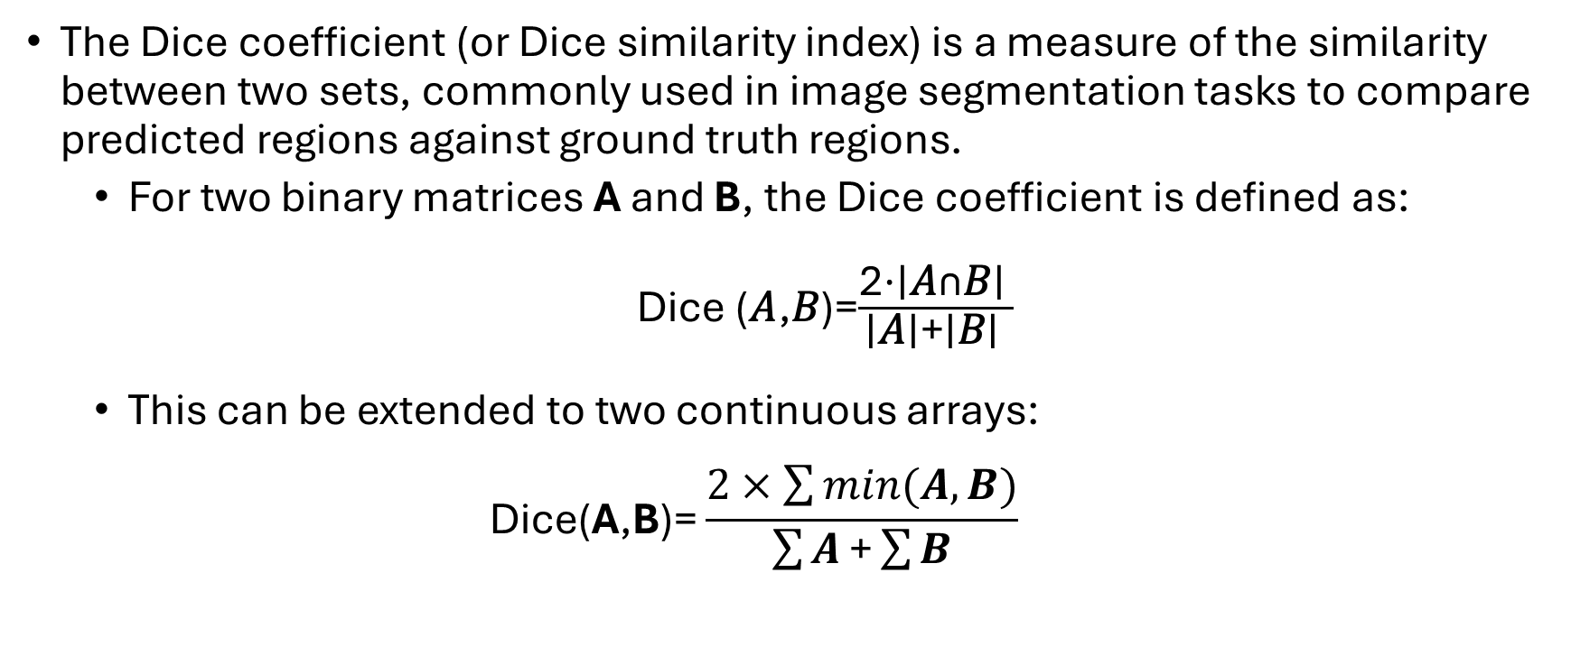
DICE value
The Dice coefficient (or Dice similarity index) is a measure of the similarity between two sets, commonly used in image segmentation tasks to compare predicted regions against ground truth regions.
For two binary matrices A and B, the Dice coefficient is defined as:
Dice (𝐴,𝐵)=$\frac{\text{2⋅∣}\text{A}\text{∩}\text{B}\text{∣ }}{\text{∣}\text{A}\text{∣+∣}\text{B}\text{∣ }}$
This can be extended to two continuous arrays:
$$\text{Dice}\text{(}\text{A}\text{,}\text{B}\text{)=}\frac{2×\sum{min⁡(A,B)}}{\sum{A}\text{+}\sum{B}}\text{​}$$
Notes:
Where: ∣𝐴∩𝐵∣ is the number of overlapping elements (i.e., the number of True or 1 values in both A and B). ∣𝐴∣ and ∣𝐵∣ are the number of True or 1 values in A and B, respectively.

Slide 28
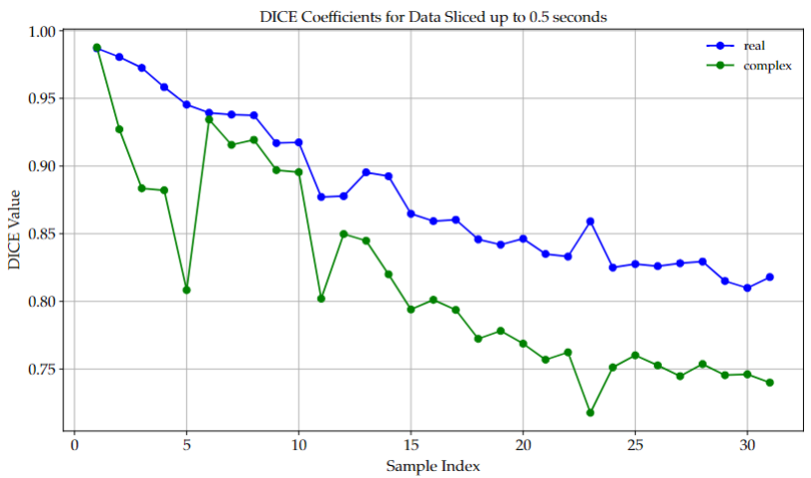
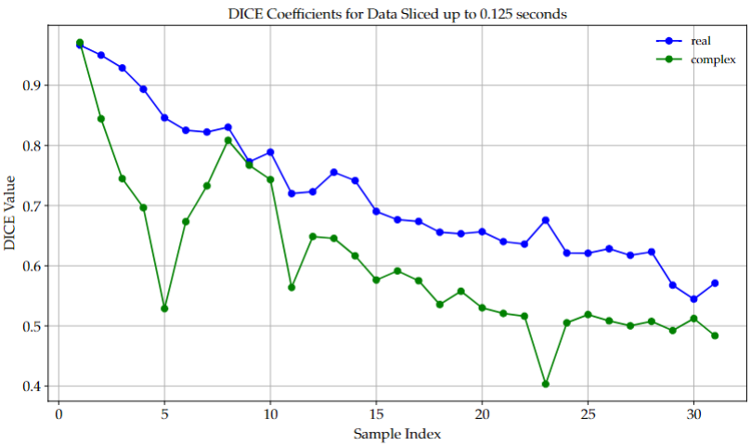
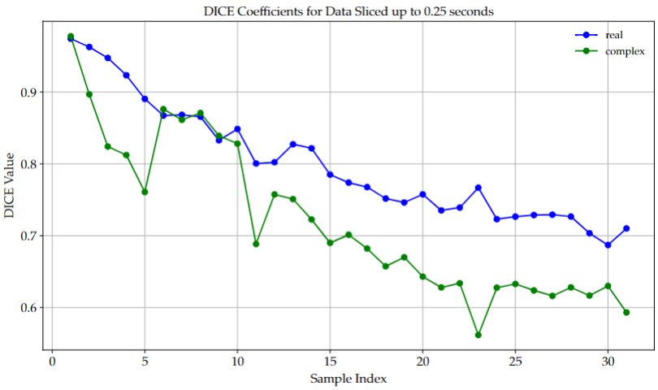
DICE graphs forward slicing
80 values
20 values
40 values

Slide 29
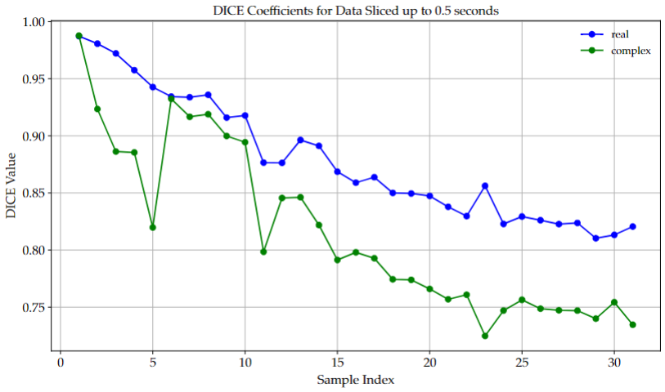
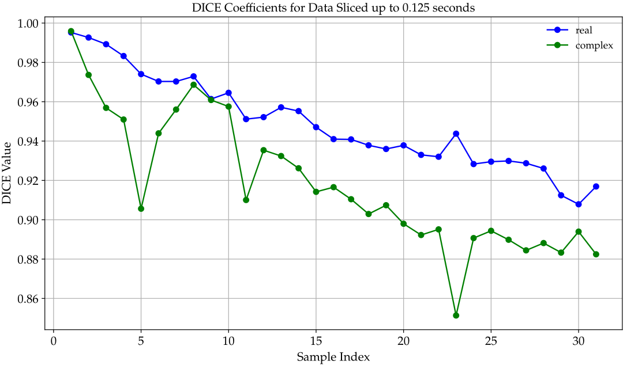
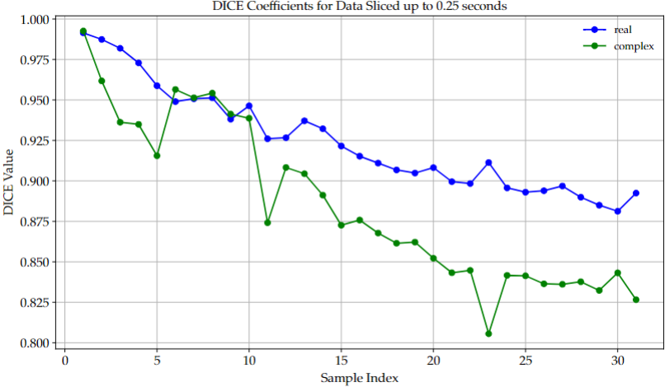
DICE graphs backward slicing
80 values
20 values
40 values

Slide 30
Conclusion
Based on the analysis of this dataset;
Using color mapping based on the mean ± 3 standard deviations is the most effective approach.
The median and adjustments to the standard deviation have no noticeable impact on the results.
The Root Mean Squared (RMS) provides a different perspective compared to the mean or median
Important information is not encoded in periodic points but rather across a given time spread, however further investigation into this is needed.
It may be possible to reduce the time spent on each pixel by up to 75%, depending on the variation in the time spread.
Work could be done to come up with a numerical way to
Notes:
Also tried geometric and harmonic means are terrible

Slide 31
Thanks to Fabian
Link to GitHub repository

